Slide 1
Microwave Circuit Design Project Report
Directional Coupler Microstrip Line
Student name - Matrikel
Ngoc An Ha - 967813
Nam Hung Le - 967826

Slide 2
Step 1: Calculate odd mode and even mode characteristic impedance
Step 2: Transformation to a structure realizable in microstrip line circuit
Ideal couple transmission line element (CLIN) .
Microstrip couple line (MCLIN).
Step 3: Include all microstrip line discontinuities.
Step 4: Optimize the circuit.
For -10 dB
For -13 dB
Step 5: Process on making the real circuit.
Coupler type: Directional Coupler
Center Frequency F₀ = 2 GHz | Coupling Coefficient C = - 10 dB

Slide 3
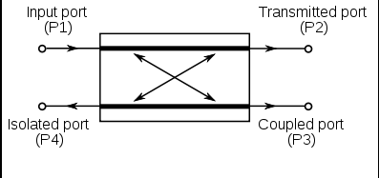
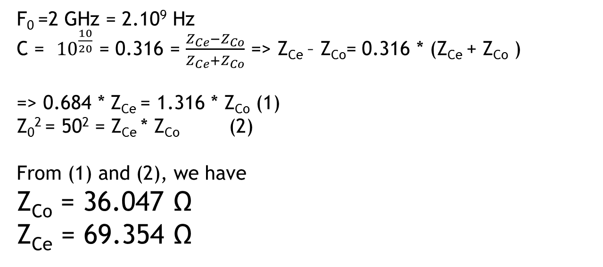
Formular
S₁₁: Reflection coefficient
S₂₁: Transmission coefficient
S₃₁: Coupling coefficient
S₄₁: Isolation
/S₄₁-S₃₁ /: Directivity
F₀ =2 GHz = 2.10⁹ Hz
C = ${10}^{\frac{10}{20}}$ = 0.316 = $\frac{Z_{Ce}−Z_{Co}}{Z_{Ce}+Z_{Co}}$ => Z_{Ce} – Z_{Co}= 0.316 * (Z_{Ce} + Z_{Co} )
=> 0.684 * Z_{Ce} = 1.316 * Z_{Co} (1)
Z₀² = 50² = Z_{Ce} * Z_{Co} (2)
From (1) and (2), we have
Z_{Co} = 36.047 Ω
Z_{Ce} = 69.354 Ω

Slide 4
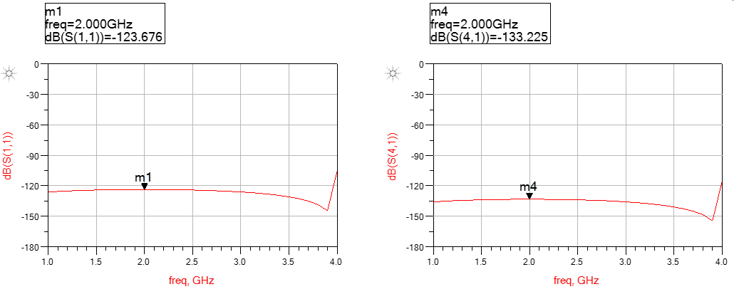
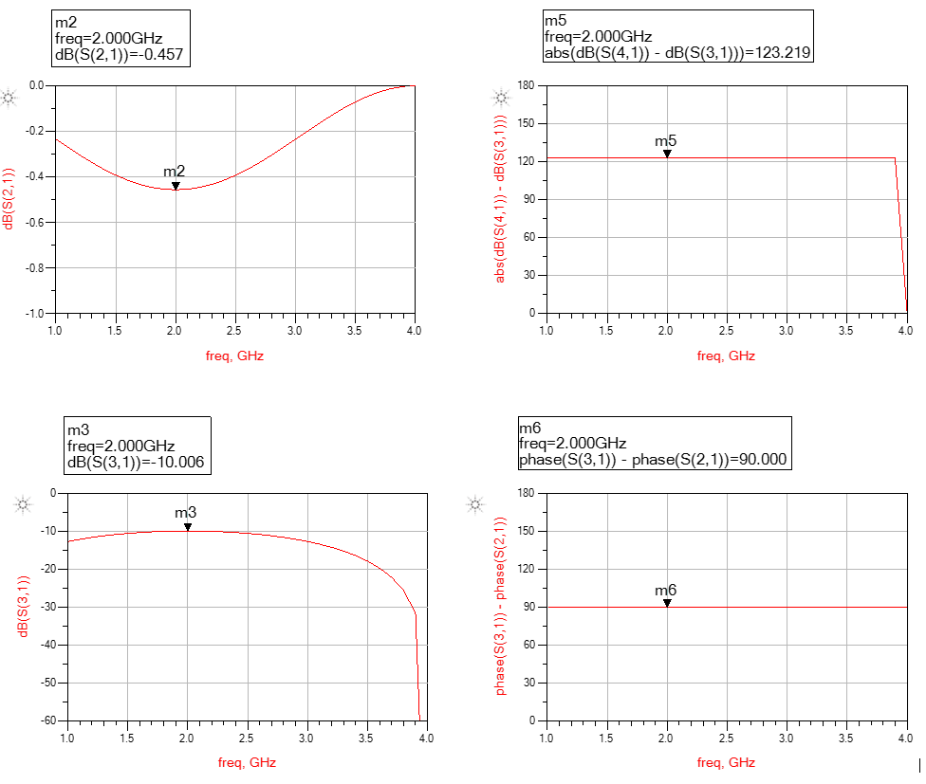
Create Ideal circuit
At 2 GHz, the coupling coefficient S31 is at -10dB.
=> The calculation results of Z_{ce} and Z_{co} are right.

Slide 5
Transforming to Microstrip Couple Line element MCLIN circuit
Using the tool LineCal of ADS, with
Effective Electrical Length E_Eff of coupled section = 90 degree
Center frequency at 2 GHz

Slide 7
Optimization
We add transmission line MLIN at both terminals. Their widths W(s) are 1.70584 mm, it is equivalent to 50 Ohm transmission line.

Slide 9
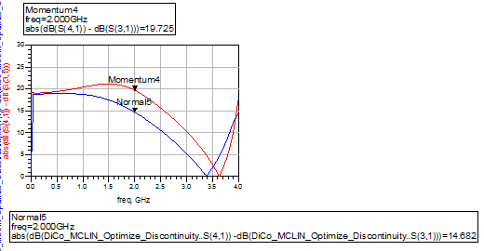

Slide 10
Optimization for -13 dB

Slide 13
Using Network Analyzer to test the circuit and get the measurement result.

